Slide 1

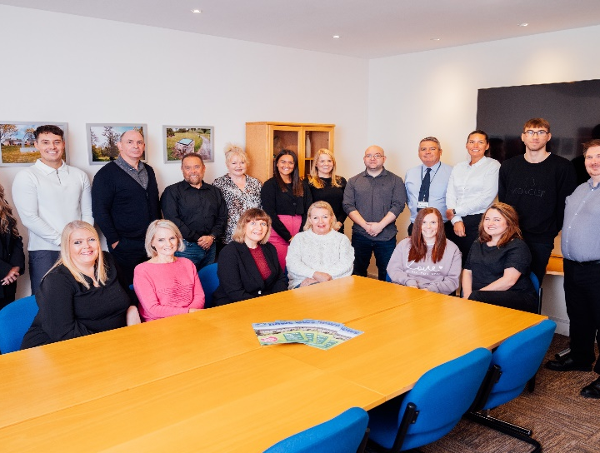
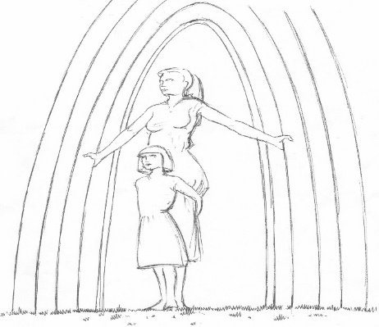
1998 -2025
Annual General Meeting
2025

Slide 2
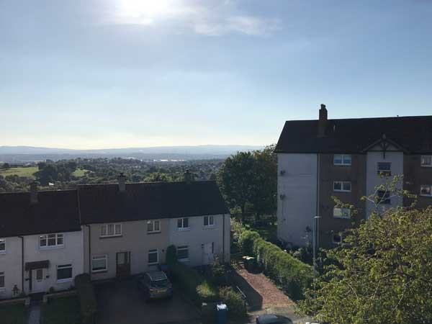
CEO’s Report to the Shareholders
Notes:
Good evening share members, welcome to Knowes’ 28th annual general meeting and it is great to have so many of you here this evening.
This is an evening to celebrate our achievements throughout the past year, and discuss our plans for the year ahead.

Slide 3
Knowes’ mission, vision, strategy and values
Mission – good quality affordable homes, services, meet needs and aspirations of our customers, ensure customer involvement and drive positive change
Vision – shape the future of housing and improve the quality of our community
Strategy – strengthen, diversify and grow
Core values – Respect and Equality, Customer focussed, communication, continuous improvement, honesty & professionalism
Notes:
You will all have received our annual report for 2024/25 which is located within the summer newsletter.
On page 23 you will find Knowes’Mission and Vision statements as well as our overall strategy and the core values of the organisation.
The mission statement explains what Knowes is all about and what it does and our vision is about our aspirational goals for the future. At least once a year Knowes’ committee and staff will gather together to discussion our Mission and Vision statements to discuss if these still represent Knowes, what we do and where we are going as an organisation. The statements have been revised over the years but only to refresh and update the language and not in their essence. We are still proud to be a community centred organisation providing services to the people of Faifley and Duntocher.
Our overall strategy explains how we will achieve our goals and objectives and our core values are the fundamental principles which guide our culture, our decisions and how we behave.

Slide 4
Business Objectives
Value for money
Build new properties
Energy improvement
Community projects
Community engagement
Committee
Governance
Stock condition
Improving services to customers
Wellbeing for staff and committee
Improving our estate
Health and safety
Financial viability
Digital engagement
Notes:
Our business objectives are detailed in page 24 of the report and these are our target which we endeavour to meet over the course of the year and what we measure our success against. I have broadly summarised these under the headings here.

Slide 5
Meeting our objectives – Value for money
  Consult our customers and ask them for their opinion of our services
  Utilise competitive procurement tools
  Monitor our income and expenditure against budgets
  Set key performance indicators and benchmark these against peer group housing associations and the industry average
  Knowes’ rent increase 25/26 3.5%, peer group average 3.9%,
  Overall customer satisfaction with service 91%, peer group average 89%.

Slide 6
Providing Value for money cont’d
  Satisfied with quality of home 86%, peer group average 83%
Rents lost through houses being empty Knowes – 0.1% average 0.37%
Days taken to let properties – Knowes 5.6, Group average 19.3 days
Gross rent arrears at 31/3 – Knowes – 1.1%, group average 2.7%
Complaints rec’d per 100 units of ownership – Knowes – 2.9, group average 5.8

Slide 7
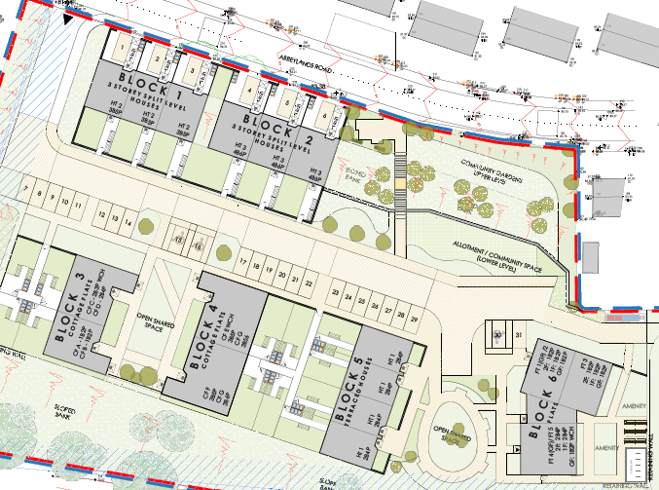
Growing our housing stock
Land purchased and old pavilion demolished at Abbeylands Road site
Scottish Government has asked for changes to design to reduce property sizes and hence reduce build costs
Possible new start date in 2026
In the meantime we have obtained £441k in SG Grants with another £200k expected this year to purchase in total 17 family properties in the area for social tenancies

Slide 8
Energy Improvements
Looking ahead:-
  All of our New build development properties will have net zero clean energy heating systems
  Improve the fabric of our existing buildings to be more energy efficient
  All properties to be installed with net zero heating systems by 2045 (currently 80% of households in Scotland use GCH)
96% of our stock has an EPC rating of C and above
Last 2 years we have spent £0.9m on new windows and doors for our properties
Programme of window replacement for this year £0.3m

Slide 9
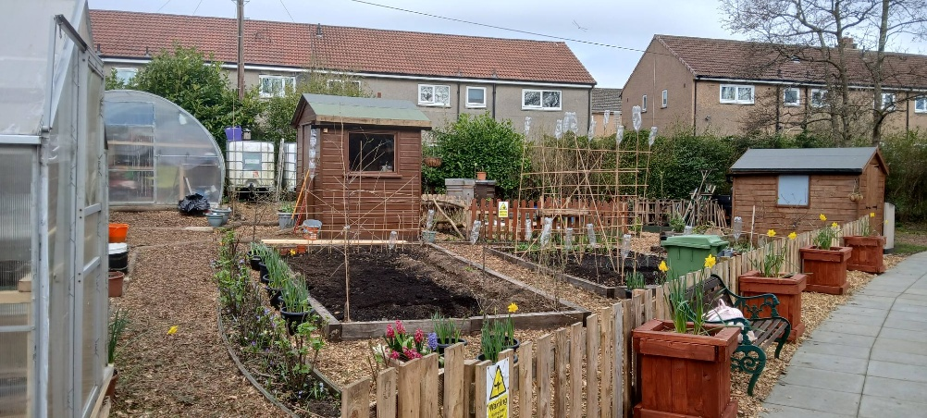
Funding for the local community
In 2024/25 we have provided the following:-
Dedicated money and energy advisors in partnership with Community Links Scotland and WDC social landlords
Community support officer in partnership with CHA and DPHA
Tenancy sustainment support for new and existing tenants
Cycle facilities
Supported Flourishing Faifley
Annual bus trip

Slide 10
Community Engagement, Committee & Governance
Customer surveys
Committee Working Group
Annual Assurance Statement
Internal Audits
External Audits
Landlord Health and Safety audits
Annual return on the Charter
4 new committee members in the past year
Governance Review

Slide 11
Stock condition – spend over next 5 years
Proportion of stock meeting SHQS – 95%, peer group average 93%
Stock condition survey 2024
Next 5 years - £3.7m set aside for kitchen replacements
£1.2m bathroom replacements
£1.5m new CHS
£0.3m windows/doors
Close cleaning & bulk uplifts £0.9m
Upkeep of common areas £1m
Gas servicing, electrical testing, painting etc £1.8m

Slide 12
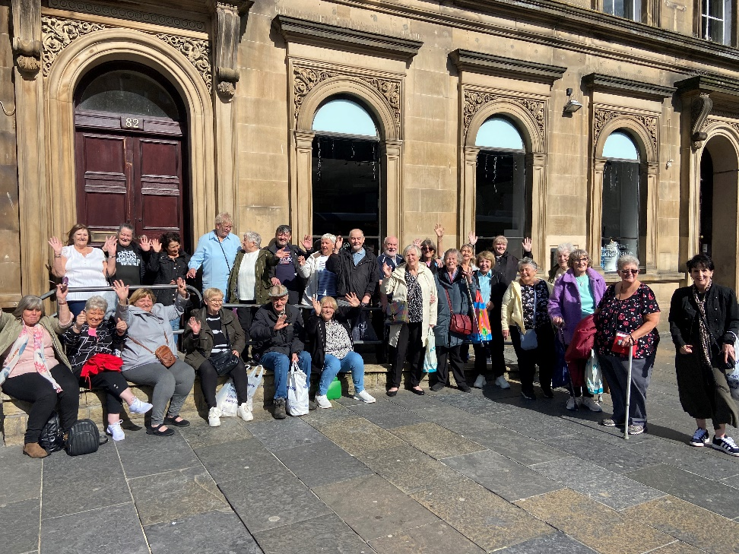
Improving services to customers
3 (25%) of our committee are tenants
Increasing share membership
Customer Working Group
Encouraging more tenants and local residents on to our Committee

Slide 13
Improving financial viability`
The Association continues to be financially strong
Annual budgets – monitor income and expenditure, review of costs
Scenario Planning/Analysis of risks
Five year projections – returns for Scottish Housing Regulator
Annual rent review in consultation with our tenants
Thirty year projections including life cycle costings for replacing

Slide 14
Challenges ahead
Meeting the Scottish Government requirement for clean energy systems in all homes by 2045
Meeting the housing supply shortage
Meeting the needs of an aging population
Recruiting and retaining skilled staff and committee members
Shortage of skilled contractors
Meeting the challenges of the digital age

